Slide 1
Anesthesia for urologic surgeries
Meron A.
June, 20234

Slide 2
Contents
  Urologic surgeries
  Pathologies of prostate gland
    BPH
    Prostate cancer
  Anesthesia for prostate surgeries

Slide 3
Introduction
Urological procedures range in impact from simple outpatient cystoscopy to surgical procedures with increased risk of perioperative complications
Patients undergoing genitourinary procedures may be of any age, but many are elderly with coexisting medical illnesses, including kidney dysfunction.
Use of lithotomy and steep head-down (Trendelenburg) positions complicates many of these procedures
Advances in preoperative optimization, perioperative management, and postoperative rehabilitation allow patients with comorbidities to be a candidates for the planned operations

Slide 4
Prostate surgery
The prostate is a secretory secondary sexual organ which is wrapped around the urethra between the urinary bladder and pelvic floor.
Normal weight- 20 g
It Is enclosed within a capsule composed of collagen, elasten & large number of smooth muscles
It consists closely integrated zones—transitional, peripheral, and central zones.

Slide 5
Each zone consists of secretory, smooth muscle, and fibrotic tissue.
  Transitional zone: The area surrounding the prostatic urethra. It is the area where BPH occurs
  Central zone: The area surrounding the ejaculatory duct
  Peripheral zone: covers the posterior & lateral aspects of the prostate. It is the most common area affected by chronic prostatitis & prostate cancer.

Slide 6
The gland is rich in blood supply mainly from inferior vesical artery. Middle rectal and inferior pudendal artery also accounts for some of blood supplies.
Venous drainage is via vesical plexus, internal pudendal veins and vertebral venous plexus
Arteries and veins penetrate the prostatic capsule and branch inside the gland
The venous sinuses adjacent to the capsule are particularly large.
Notes:
All zones are enclosed in one capsule.

Slide 7
It is innervated by both sympathetic and parasympathetic nerves.
  SN arise from T11-L2 and inferior hypo gastric plexus
  PSN supplied by S2-S4 and pelvic splanchnic nerve.
The common conditions affecting the prostate are benign prostatic hypertrophy (BPH) and prostate cancer.

Slide 8
Benign Prostatic Hyperplasia
  Benign prostatic hyperplasia (BPH) is a nonmalignant enlargement of the prostate caused by excessive growth of both the glandular and stromal elements of the gland.
  The hypertrophied lobes of prostate may obstruct the vesical neck or prostatic urethra, causing incomplete emptying of the bladder and urinary retention.
  BPH is common worldwide in men older than 60 years and may also occur above 40 years of age.
  The exact etiology is not known
Notes:
BPH occurs in about 50-60% men around the age of 60s. This may increase upto 80-90% if the age exceeds 70 years old.

Slide 9
Age-related detrusor dysfunction, an androgen-related phenomenon, plays an additional significant role
Failure to empty and LUTS can be related to an outlet obstruction or to detrusor under-activity of the bladder or to a combination of both.
As a result, a gradual dilation of the ureters (hyroureter) and kidneys (hydronephrosis) can occur.
Urinary tract infections may result from urinary stasis. Urine remaining in the urinary tract serves as a medium for infective organisms.

Slide 10
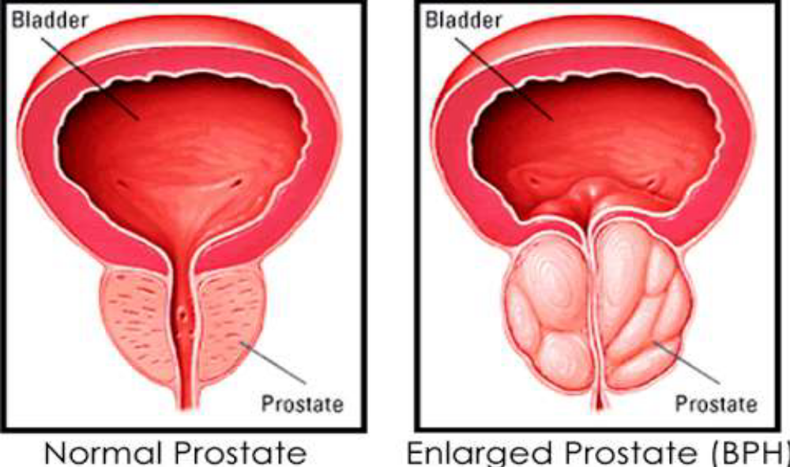

Slide 11
Prostate cancer
  Adenocarcinoma of the prostate is the most common non skin cancer in men
  Second most common cause(next to lung ca) of cancer related death in men older than 55 years.
  Approximately one in six men will be diagnosed with prostate cancer in their lifetime.
  Many patients present late, with metastatic disease which is usually to bones or lymph nodes.

Slide 12
Prostate specific antigen (PSA) levels in the blood may be used as a screening test for prostate cancer
Digital rectal examination is important in diagnosis, and fine-needle aspiration or tru-cut biopsy gives a definitive diagnosis.
Transrectal ultrasound is used to evaluate tumor size and the presence or absence of extracapsular extension.

Slide 13
Etiologies and risk factors
  Exact etiologies not known
  Old age
  Family history
  Ethnicity
  Excess androgen and estrogen
  Smoking and alcoholism

Slide 14
Clinical features
Many symptoms of BPH stem from obstruction of the urethra and gradual loss of bladder function, which results in incomplete emptying of the bladder.
  A weak or slow urinary stream
  A feeling of incomplete bladder emptying
  A delay in starting urination
  Frequent urination
  Urinary urgency
  Awakening frequently at night to urinate
  A urinary stream that starts and stops
  The need to strain to urinate

Slide 15
BPH is responsible for the majority of urinary symptoms in men, and one third of male octogenarians will have to undergo prostatic surgery.

Slide 16
Treatments
Medical treatment goals:
  To reduce prostate size (volume) or decrease intraprostatic resistance
  Restore bladder function
  Relive signs and symptoms and
  prevent and treat complications

Slide 17
Medical therapy
  Alpha reductase inhibitors: are moderately effective for symptomatic treatment of BPH. Ex, Finasteride
  Alpha blockers: are administered to block adrenergic receptors in hyperplastic prostatic tissue, the prostatic capsule, and the bladder neck, and thereby decrease smooth muscle tone and resistance to urinary flow
  Relax the smooth muscle of the bladder neck and prostate, thus improves urine flow and relives BPH symptoms
Notes:
The treatment Plan depends on the cause of BPH, the severity of the obstruction, and the patient’s general health conditions.
◆ If the patient is admitted on an emergency basis because he can not void, he is immediately catheterized.
Prostatic tissue growth is androgen sensitive, so that androgen deprivation decreases the size of the prostate and thereby the resistance to outflow through the prostatic urethra. Finasteride, an inhibitor of the 5α-reductase enzyme, is moderately effective for symptomatic treatment of BPH. Side effects of 5α-reductase inhibitors are minimal. α-Adrenergic antagonists (terazosin, doxazosin, tamsulosin) are administered to block adrenergic receptors in hyperplastic prostatic tissue, the prostatic capsule, and the bladder neck, and thereby decrease smooth muscle tone and resistance to urinary flow. These drugs also have antihypertensive effects and may cause orthostatic hypotension in some patients.

Slide 18
Surgical therapy
Invasive treatments; although most patients are treated medically, some require surgical intervention.
  Transurethral microwave thermotherapy (TUMT)
  Transurethral needle ablation (TUNA
  Transurethral incision of the prostate (TUIP) and
  Transurethral resection of the prostate (TURP)
  Open prostatectomy

Slide 19
Newer procedures using laser therapy or laparoscopic prostatectomy to destroy prostate tissue have also been developed.
Advantages of laser ablation are brief duration of surgery and minimal hemorrhage

Slide 20
TURP
TURP is the most commonly performed operation for bladder outflow obstruction .
Usually considered as a gold standard treatment now a days.
It involves the surgical removal of the prostate’s inner portion via an endoscopic approach through the urethra, with no external skin incision
Performed in the lithotomy position using a resectoscope, through which a diathermy loop is passed.
Notes:
TURP involves resection of prostatic tissue using electro cautery or sharp excision.
The procedure is associated with a fair amount of bleeding; patients are admitted postoperatively for continuous bladder irrigation to prevent the formation of obstructing blood clots

Slide 21
The prostatic tissue is resected in small strips under direct vision using the diathermy loop.
The bladder is continuously irrigated with fluid to provide surgeons clear vision of prostate tissue and wash out pieces of resected tissues.
Prostatic capsule should be preserved as much as possible to prevent absorption of large amounts of irrigating fluid into circulation, periprostatic and retroperitoneal spaces

Slide 22
Despite advanced age and multiple comorbidities, this procedure is associated with less perioperative mortality and morbidity (<1%)
Indications for TURP include
  Obstructive uropathy,
  Bladder calculi, and recurrent episodes of urinary retention,
  Urinary tract infections, and hematuria.
  Patients with prostate cancer who are not candidates for radical prostatectomy may also benefit from TURP to relieve urinary obstruction.

Slide 23
TURP procedure requires irrigation of large amount of fluids
The ideal safe irrigating fluid for use during TURP is one that should be isotonic, non-hemolytic, and nontoxic, not metabolized, and excreted rapidly if absorbed
In addition, surgical properties of such a fluid should include being non electrolytic to disperse the electrical current, transparent to allow clear visibility, and inexpensive, given the large volume that is necessary

Slide 24
No such irrigation solution currently exists
Numerous nearly isotonic irrigation solutions are available.
Commonly used solutions are glycine 1.2% and 1.5%, mannitol 3% to 5%, glucose 2.5% to 4%, sorbitol 3.5%, Cytal (a mixture of sorbitol 2.7%, and mannitol 0.54%), and urea 1%
These solutions are purposely moderately hypotonic to preserve their transparency.

Slide 25
Although these irrigation solutions cause no significant hemolysis, excessive absorption of them can lead to other complications, such as pulmonary edema and hyponatremia.
In addition, the solutes can have adverse effects.
Distilled water is electrically inert and inexpensive and has excellent optical properties, but it is extremely hypotonic.
When absorbed into the circulation in large amounts, plain water causes hemolysis, shock, and renal failure

Slide 26
Significant absorption of any irrigating solution can cause over hydration and volume overload, and all but the balanced salt solutions also cause dilutional hyponatraemia.
The conductivity of balanced electrolyte solutions such as Ringer lactate interferes with electrocautery and disperses electrical current from the resectoscope, potentially posing a risk to patient and surgeon.
Sorbitol and glucose cause significant hyperglycemia if absorbed.
Glycine, a nonessential amino acid, is normally metabolized by oxidative transformation into ammonia.

Slide 27
Factors affecting absorption of irrigation
  Duration of resection
  Height of irrigation fluid (hydrostatic pressure)
  Size of gland and extent of resection
  Number and size of open sinuses

Slide 28
How to minimize absorption?
  Limit resection to <1 hr
  Irrigation fluid no more than 30 cm (@ the beginnning ) and 15 cm (@ final resection time) above operating table
  Avoid hypotonic solution
  Treat hypotension with vasopressors than fluid infusion

Slide 29

Because of the characteristics of the prostate and the large amounts of irrigation fluid often used, TURP can be associated with serious complications
The most common surgical complications of TURP are
  Clot retention,
  Failure to void,
  Uncontrolled hematuria requiring surgical revision,
  Urinary tract infection, and chronic hematuria,
  Other complications may include TURP syndrome,
  bladder perforation,
  Sepsis,and
  Disseminated intravascular coagulation (DIC).
Most common
Less common

Slide 30
TURP Syndrome
Transurethral prostatic resection often opens the extensive network of venous sinuses in the prostate, potentially allowing systemic absorption of the irrigating fluid.
The absorption of large amounts of fluid (>2 L) results in a constellation of symptoms and signs commonly referred to as TURP syndrome
The incidence of TURP syndrome is less than 1%.

Slide 31
Clinical manifestations of the TUR syndrome range from mild (restlessness, nausea, shortness of breath, dizziness) to severe (seizures, coma, hypertension, bradycardia, cardiovascular collapse).
The manifestations are primarily those of circulatory fluid overload, water intoxication, and, occasionally, toxicity from the solute in the irrigating fluid.
The syndrome is most commonly associated with large-volume prostate resection and use of large volumes of irrigation fluid

Slide 32
This syndrome presents intraoperatively or postoperatively as headache, restlessness, confusion, cyanosis, dyspnea, arrhythmias, hypotension, seizures, or a combination of these, and it can be rapidly fatal.
In the awake patient with a regional block, a classic triad of symptoms has been described that consists of an increase in both systolic and diastolic pressures associated with an increase in pulse pressure, bradycardia, and mental status changes

Slide 33
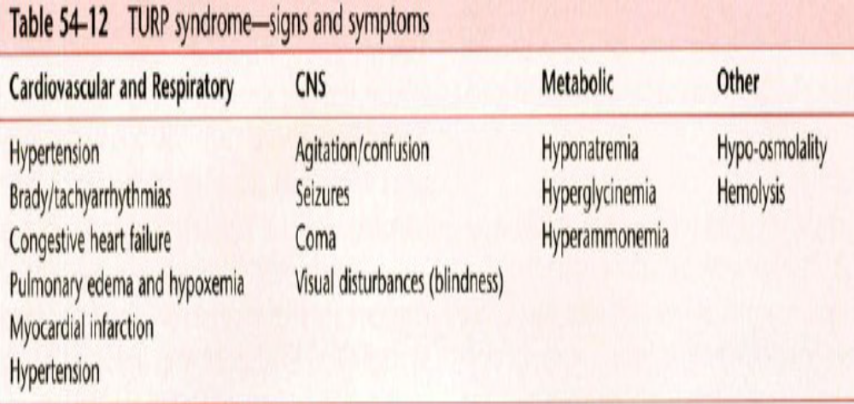

Slide 34
Management of TURP syndrome
  Treatment depends on early recognition and should be based on the severity of the symptoms
  Notify the surgeons to terminate surgery as early as possible
  The hallmark of treatment is to restore extracellular tonicity
  Ensure oxygenation and circulatory support
  Fluid restriction and intravenous administration of furosemide for mild symptoms
  Symptomatic patients with serum sodium concentrations <120 mEq/L be corrected with hypertonic saline

Slide 35
Serum electrolytes should be followed closely, and the hypertonic saline discontinued when the patient is asymptomatic or serum sodium concentration exceeds 120 mEq/L
Consider insertion of invasive monitors if cardiovascular instability occurs
Send blood to laboratory for evaluation of electrolytes, creatinine, glucose, and arterial blood gases

Slide 36
Bleeding
A hypertrophied prostate is highly vascular, and operative bleeding can be significant (inaccurate and difficult estimation)
Abnormal bleeding after TURP occurs in less than 1% of cases

Slide 37
Blood loss can be quantified based on resection time (2 to 5 mL/min of resection time) and size of the prostate in grams (20 to 50 mL/g)
The patient’s vital signs and serial hematocrit values should be monitored to assess the blood loss and need for transfusion
If primary fibrinolysis is suspected, aminocaproic acid can be effective when given intravenously in a dose of 4 to 5 g during the first hour, followed by 1 g/hr.
Usage of tranexamic acid is also found to be important

Slide 38
Use of adrenergic agonists would cause vasoconstriction of prostatic blood vessels and a decrease in blood loss
If bleeding becomes uncontrollable, the procedure should be terminated as quickly as possible, and a Foley catheter should be passed into the bladder and traction applied to it.
The catheter’s inflated balloon exerts lateral pressure on the prostatic bed and reduces bleeding.

Slide 39
Bladder perforation
This may occur in up to 1% of cases
Usually occur during difficult resections and are most often made by the cutting loop or knife electrode.
May result from either the resectoscope going through the bladder wall or from over distention of the bladder with irrigation fluid
Most bladder perforations are extraperitoneal and are signaled by poor return of the irrigating fluid.

Slide 40
Awake patients will typically complain of nausea, diaphoresis, and retropubic or lower abdominal pain.
Large extraperitoneal, and most intraperitoneal, perforations are usually even more obvious, presenting as sudden unexplained hypotension or hypertension, and with generalized abdominal pain in awake patients.
Regardless of the anesthetic technique employed, perforation should be suspected in settings of sudden hypotension or hypertension, particularly with acute, vagal-mediated bradycardia.

Slide 41
Anesthesia for TURP
Safe anesthetic management depends on detection and optimization of co-existing diseases, and weighing the relative risks and benefits of regional and general anesthesia for each patient
Patients presenting for prostate surgery are often elderly and may have co-existing morbidities. Cardiovascular and respiratory problems are not uncommon, and they are often on various medications.
Due to the advanced age of the population presenting for prostatectomy, an emphasis on comorbid disease in preoperative evaluation is particularly relevant.

Slide 42
Preoperative evaluation
Patients presenting for TURP are likely to be elderly and may have other serious comorbidities.
Cardiovascular and respiratory problems are not uncommon, and they are often on various medications.
Specific problems related to their prostatic disease include an element of renal impairment, anemia due to recurrent hematuria, or urinary tract infection.
Occasionally, patients are dehydrated and depleted of essential electrolytes (long-term diuretic therapy and restricted fluid intake).

Slide 43
Long standing urinary obstruction can lead to impaired renal function and chronic urinary infection
TURP is reported to carry a 0.2–6% mortality rate with common causes of death include myocardial infarction, pulmonary edema, and renal failure
Preoperative evaluation should be directed toward the detection and treatment of these conditions before anesthesia
Notes:
Preoperative
Patients presenting for prostate surgery are generally elderly and may have preexisting medical problems, including CAD, CHF, PVD, cerebrovascular disease, COPD, and renal impairment. Preop evaluation should be directed toward the detection and treatment of these conditions before anesthesia.
P.865
Respiratory COPD common in this age group. Patients with > 50 pack/year smoking Hx, or with any respiratory Sx, may need PFTs. For dyspnea with moderate exercise, [check mark] VC, FEV₁, MMEF. If VC < 80%, FEV₁ < 60%, or MMEF < 40% predicted, [check mark] ABG. If ABG and PFT markedly abnormal, consider postponing surgery until patient's respiratory condition has been optimized.
Tests: PFT; CXR; ABG, as indicated from H&P. Cardiovascular HTN, CAD common in this age group. Assess exercise tolerance by H&P (e.g., should be able to climb a flight of stairs without difficulty or SOB).
Tests: ECG; others as indicated from H&P. Neurological Cerebrovascular disease, Alzheimer's, and other neurologic problems may be present in this age group. Assess mental status to guide evaluation of any intraop or postop changes. Renal Anticipate renal impairment 2° chronic obstruction.
Tests: BUN; Cr; electrolytes. If ↑ BUN and ↑ Cr, [check mark] creatinine clearance (nl = 95–140 mL/min). Musculoskeletal Various arthritides in this age group may cause problems with positioning for regional anesthesia and surgery. Endocrine Increased incidence of DM. Hematologic Moderate blood loss expected with larger glands. If gland < 80 g, no T&C necessary.
Test: Hct Laboratory Other tests as indicated from H&P. Premedication Continue commonly used drugs (e.g., digitalis, β-blockers, NTG) to prevent cardiovascular problems. Sedation prn anxiety (e.g., lorazepam 1–2 mg po 1–2 h before surgery).

Slide 44
Prostatic surgery carries a high risk of intra-operative bleeding, and so ideally all patients should have blood taken for cross matching.
Although a type and screen are adequate for most patients, blood should be available and cross matched for anemic patients as well as patients with large glands (> 40 g).
Prostatic bleeding can be difficult to control through the cystoscope. At least 2 units of blood should be prepared

Slide 45
Anticoagulant drugs such as aspirin and non-steroidal anti-inflammatory drugs should be stopped 10 days prior to surgery
Those requiring continuous anticoagulation may need to be changed into intravenous heparin, which can then be stopped for the duration of surgery

Slide 46
Investigations
  CBC and Rh
  Electrolytes
  ECG and echo
  Renal function tests
  Urinalysis
  Blood glucose level

Slide 47
Patient preparation
  Optimize comorbid problems
  Consideration of ongoing drug therapy
  Antibiotic prophylaxis (in case of urinary tract infection or urinary obstruction)
  Blood preparation and management
  Preload and premedicate

Slide 48
Intraoperative management
Regional block allows the patient to remain awake, which can facilitate early diagnosis of TURP syndrome and enable diagnosis of bladder perforation (shoulder pain due to diaphragmatic irritation by blood or fluid).
Regional techniques may be better tolerated in the elderly, avoiding the cardiovascular and respiratory depressant effects of general anesthesia, provided there are no contra-indications.
Regional anesthesia may also decrease blood loss compared with general anesthesia. Additionally, the need for analgesics is increased approximately fourfold after general anesthesia compared with regional anesthesia.

Slide 49
Advantage of regional anesthesia over general anesthesia
  Regional anesthesia offers several advantages over general anesthesia for TURP such as:
  Reduced blood loss and circulatory overload, reduced incidence of DVT, better assessment of mental status, decreased analgesic request, avoids catastrophic effect of GA pulmonary pathology, preserves neuroendocrine and immune responses, cost effective

Slide 50
Most commonly spinal block, has long been considered the anesthetic technique of choice for TURP.
A surgical block to the level of T10 is required for subarachnoid blocks
Epidural or combined spinal and epidural anesthesia with an epidural catheter is the best regional method for radical prostatectomy amid long duration of surgery
In addition, it has the advantage that the epidural may be used post-operatively for pain relief

Slide 51
Caudal and sacral blockade also has been used effectively for prostate surgery
Caudal anesthesia has been used effectively in high-risk patients undergoing laser prostatectomy. Hemodynamic stability is the main advantage with this technique.
General anesthesia may be necessary in patients who require ventilator or hemodynamic support, have a contraindication to regional anesthesia, or refuse regional anesthesia.

Slide 52
Monitoring
  ASA standard monitors
  Monitor and evaluate mental status
  Monitor for the signs of fluid overload ( decreased spo2)
  Blood loss is particularly difficult to assess because of the use of irrigating solutions, necessary to rely on clinical signs of hypovolemia.
  Temperature monitoring should be used during long resections to detect hypothermia
  Monitor serial intraoperative electrolyte if possible
  Care for pressure points
  EtCO2 if GA is used

Slide 53
Positioning should also be considered as patients with severe cardiac or respiratory disease may not easily tolerate the lithotomy position with slight trendelenburg tilt.
Raising the patients head and shoulders may help, and carefully administered sedation may be used.
Careful positioning is important as the lithotomy position may result in injuries to the common peroneal, femoral and sciatic nerves.

Slide 54
Postoperative complications
  Hypothermia
  Hypotension
  Haemorrhage
  Septicaemia
  TURP syndrome
  Bladder spasm
  Urethral stricture
  Clot retention
  Deep vein thrombosis
  Postoperative cognitive impairment
  Infertility

Slide 55
Open prostatectomy
Open (in contrast to transurethral or endoscopic) operations on the prostate gland are common
These operations are associated with a longer hospital stay and urinary catheter is usually placed and removed on day 4 to 6.
The risk of TURP syndrome is less with open procedures

Slide 56
A Simple open prostatectomy via different approaches (perineal, retropubic and transvesical) is occasionally required for resection of very large prostate glands affected by benign prostatic hypertrophy (BPH)
These approaches are associated with less bleeding
Radical prostatectomy: involves removal of entire prostate with local pelvic lymph nodes and seminal vesicles with nerves and veins surrounding it
Usually reserved for prostate cancer which is associated with significant bleeding i,e requires transfusion

Slide 57
Venous air embolism may occur if the patient is placed in the supine trendelenberg position with the pubis above the head.
As with any long operation, careful patient positioning and methods to reduce heat loss are important

Slide 58
Anesthesia considerations
  Regional (spinal, continuous spinal, continuous lumbar epidural), GA, or combined techniques are acceptable.
  If regional anesthesia used, optimal block level is T8-T10 (depending on incision site).
  Advantages of regional anesthesia include potential for lower intraoperative blood loss, possible lower incidence of DVT postop, and faster return of bowel function.
  Laparoscopic and robotic prostatectomy is usually done under general endotracheal anesthesia

Slide 59
Radical retro-pubic prostatectomy may be accompanied by significant operative blood loss.
Average blood loss for radical prostatectomy surgery is between 500 and 1500 mL and approximately 10% of patients will require a perioperative blood transfusion
Intraoperative blood loss is significantly less if epidural anesthesia or a combined epidural and general anesthetic with spontaneous ventilation is used.

Slide 60
Epidural analgesia is used in some centers following retro-pubic prostatectomy and may improve analgesia and accelerate recovery
The preemptive analgesia provided by the epidural block decreases postoperative pain and analgesic requirements.
Homeostasis of neuroendocrine responses may be better maintained with regional block than with general anesthesia.

Slide 61
Epidural anesthesia alone or when added to a general anesthetic decreases the risk of thromboembolism, decrease postoperative pain and analgesic requirements, length of hospitalizations and speeds recovery of bowel function.
TAP block may be utilized for post operative analgesia

Slide 62
Postoperative complications include
  Hemorrhage;
  Deep venous thrombosis;
  Pulmonary embolus;
  Injuries to the obturator nerve, ureter, and rectum;
  Urinary incontinence and impotence.
  Thromboembolism

Slide 63
Thank you!!!
The end!!

